Slide 1
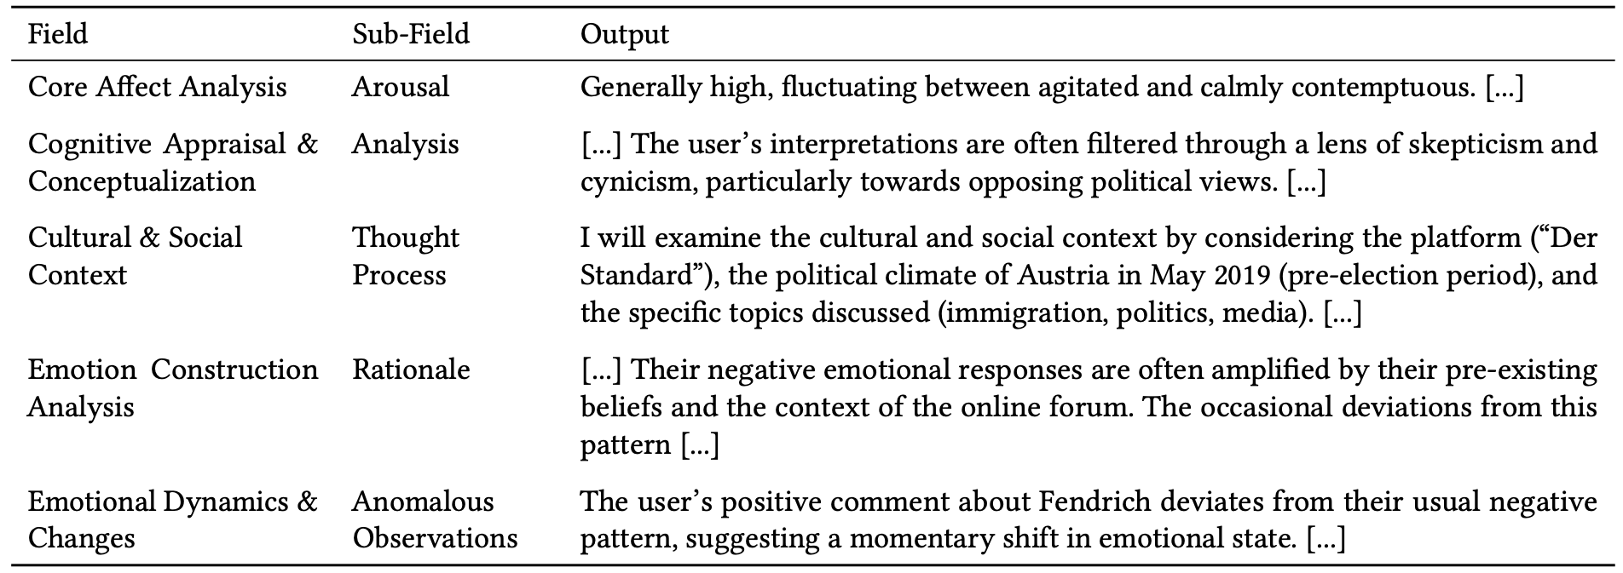




Extended Abstracts of the CHI Conference on Human Factors in
Computing Systems (CHI EA ’25) | Yokohama, Japan, April 26—May 01, 2025
Context over Categories: Implementing the Theory of
Constructed Emotion with LLM-Guided User Analysis
Nils Klüwer, Irina Nalis-Neuner, Julia Neidhardt
TU Wien Informatics
Institute of Information Systems Engineering
Research Unit Data Science
CD Lab for Recommender Systems
Overview & Contributions
B
B
Problem: Current approaches to emotion analysis rely on oversimplified categories (e.g., Ekman's universal emotions), neglecting context and individual differences [1].
Our Approach: We integrate most recent advancements in cognitive and emotion studies, by operationalization Lisa Feldman Barrett's Theory of Constructed Emotion, which emphasizes the crucial role of context in shaping emotions.
Key Contributions:
  Novel Framework: A context-aware emotion analysis pipeline using advanced LLM guidance.
  "Context Sphere": A new data construct representing a user's complete online behavior and interactions.
  LLM Adaptation: Demonstrates how to use LLMs for nuanced, context-sensitive emotion analysis.
  Focus: Content moderation and personalized systems.
A
C
C
Figure 2: Pipeline from Preprocessing to Final Output - Please note: User Study not part of this Late-Breaking Work Submission.
C: Evaluation
Methodology
  Uses LLM-as-a-Judge (GPT-4o, Claude / Haiku 3.5, Gemini 1.5 Flash) to assess LLM output
  Detecting confabulations [4] (hallucinations) – confident but misleading outputs.
  Enables rapid, iterative development and refinement of the LLM pipeline.
  Cost: Initial JSON analysis: ~$0.035 per user. Full pipeline (including Markdown report): ~$0.072 per user. Complete pipeline, including confabulation checks: ~$0.462.
Upcoming User Study not part of this Late Breaking Work
Research Question
How can we leverage Large Language Models (LLMs) to analyze emotions in a way that reflects their complex, constructed nature, rather than relying on predefined categories?
Table 1: Examples output from first LLM request
A. Context Sphere Building
Methodology
Data Source: "Der Standard" online newspaper comments and related articles (May 2019, 23,925 users).
Goal: Create a comprehensive "context sphere" for each user, encapsulating:
  All comments made by the user.
  Surrounding context (article metadata, conversation threads).
  Interactions with other users (replies, etc.).
Key Features:
  Selective Pruning: Includes relevant conversation threads up to the user's last comment, balancing context with efficiency.
  Privacy-Preserving: Excludes usernames and gender to minimize bias.
  Markdown Format: Optimized for readability by both humans and LLMs.
Results
Contextualized Emotion Analysis: The LLM successfully analyzes emotions considering individual user contexts (see Table 1 examples).
Beyond Simple Categories: Captures nuanced emotional dynamics, going beyond traditional categorical approaches.
Efficient Processing: Demonstrates efficient processing of large text volumes (21,671 tokens in ~60 seconds for ~$0.035), showcasing scalability.
B: LLM-Guidance
Core Idea: Combine the Theory of Constructed Emotion with advanced LLM techniques.
Key Techniques:
  Role-Play Prompting [7]: The LLM (Gemini-1.5 Pro) impersonates Lisa Feldman Barrett. (Include a small, simplified version of Figure 2 if space allows).
  Controlled Generation: A JSON schema guides the LLM's output, ensuring a structured analysis.
  Meta-Prompting [9]: A second LLM request generates a concise, human-readable Markdown report using a generalized template to adapt to specific instances.
Conclusion
Advances Emotion Analysis: Bridges cognitive science [2] and computational systems.
Context-Aware Applications: Enables nuanced emotion analysis.
Operationalizes Barrett's Theory: Uses "context sphere" and LLM guidance (role-play, controlled generation).
Implications: More accurate and effective development of human-centered technologies.
Ethical Implications: Reduces Bias, Addresses risks [5], Aligns with responsible AI (Digital Humanism) [8].
Captures the complexity and context of human emotions far more effectively than models rooted in Ekman’s assumptions of universal emotions [6].
Figure 1: Example of Role-Play Prompting, where the LLM takes on the persona of Lisa Feldman Barrett [7].
Limitations and Future Work
Output Structure: A multi-class JSON with five main fields the LLM must generate its response into:
  Core Affect Analysis
  Cognitive Appraisal & Conceptualization
  Cultural & Social Context
  Emotion Construction Analysis
  Emotional Dynamics & Changes
  Each field includes sub-fields like "Thought Process," "Analysis,” “Observable Patterns,” “Anomalous Behaviour” and "Rationale."
Evaluation Difficulty: Dynamic emotions lack a definitive "ground truth" [3] for standard metrics.
LLM-as-a-Judge: Current evaluation [10] is pragmatic but lacks human validation.
Framework: Trade-off between theoretical flexibility avoiding predefined categories and the practical need for computational structure.
Future Work: Validate LLM analyses with human judgement; Compare against lexicon-based and Ekman's category methods; Address large datasets; Overgeneralization; Excessive granularity.
Addressing Failure Modes: Mitigate potential overgeneralization or excessive granularity.
Ultimately, this future work aims to create more robust, reliable, and human-centered systems for understanding and responding to human emotion.
Contact
References
Nils Klüwer
e12229263@student.tuwien.ac.at
www.linkedin.com/in/nilsklue/
Irina Nalis-Neuner
recsys-lab.at/team/irina-nalis-neuner/
Julia Neidhardt
recsys-lab.at/team/julia-neidhardt/
[1] Lisa Feldman Barrett. 2017. How Emotions Are Made: The Secret Life of the Brain. Pan Macmillan. https://books.google.at/books?id=vjIvDQAAQBAJ Google-Books-ID: vjIvDQAAQBAJ.
[2] Lisa Feldman Barrett. 2022. Context reconsidered: Complex signal ensembles, relational meaning, and population thinking in psychological science. American Psychologist 77, 8 (Nov. 2022), 894–920. doi:10.1037/amp0001054
[3] Lisa Feldman Barrett and Christiana Westlin. 2021. Navigating the science of emotion. In Emotion measurement. Elsevier, 39–84.
[4] Elijah Berberette, Jack Hutchins, and Amir Sadovnik. 2024. Redefining "Hallucination" in LLMs: Towards a psychology-informed framework for mitigating misinformation. doi:10.48550/arXiv.2402.01769 arXiv:2402.01769 [cs] version: 1.
[5] Kate Crawford. 2021. The Atlas of AI: Power, Politics, and the Planetary Costs of Artificial Intelligence.
[6] Paul Ekman and Wallace V. Friesen. 1971. Constants across cultures in the face and emotion. Journal of Personality and Social Psychology 17, 2 (1971), 124–129. doi:10.1037/h0030377 Place: US Publisher: American Psychological Association.
[7] Aobo Kong, Shiwan Zhao, Hao Chen, Qicheng Li, Yong Qin, Ruiqi Sun, Xin Zhou, Enzhi Wang, and Xiaohang Dong. 2024. Better Zero-Shot Reasoning with Role-Play Prompting. doi:10.48550/arXiv.2308.07702 arXiv:2308.07702 [cs].
[8] Hannes Werthner. 2024. Digital Transformation, Digital Humanism: What Needs to Be Done. Hannes Werthner· Carlo Ghezzi· Jeff Kramer· Julian Nida-Rümelin Bashar Nuseibeh· Erich Prem· (2024), 115.
[9] Yifan Zhang, Yang Yuan, and Andrew Chi-Chih Yao. 2024. Meta Prompting for AI Systems. doi:10.48550/arXiv.2311.11482 arXiv:2311.11482 [cs].
[10] Lianmin Zheng, Wei-Lin Chiang, Ying Sheng, Siyuan Zhuang, Zhanghao Wu, Yonghao Zhuang, Zi Lin, Zhuohan Li, Dacheng Li, Eric P. Xing, Hao Zhang, Joseph E. Gonzalez, and Ion Stoica. 2023. Judging LLM-as-a-Judge with MT-Bench and Chatbot Arena. doi:10.48550/arXiv.2306.05685 arXiv:2306.05685 [cs].
Acknowledgement:

